Slide 1
FHIR in the Wild
Who’s using it and how?
Lloyd McKenzie

Slide 2
Some caveats
Difficult to know exactly what’s happening
FHIR is free – anyone can use it
FHIR is “easy” – don’t necessarily need to ask questions to roll it out
Little incentive to report use
We can measure hits on test servers, but hard to correlate that to production use

Slide 3
What we do know

Slide 4
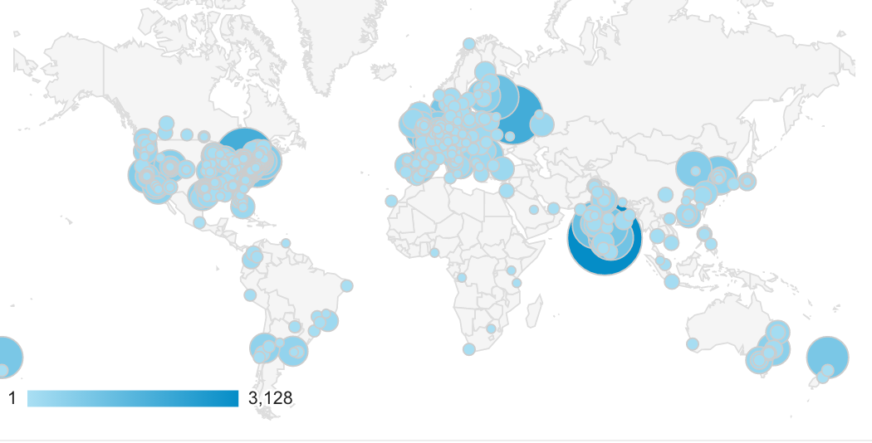
FHIR is global
Notes:
Connectathons and significant conferences in China, Chile, Russia, Vietnam

Slide 5






FHIR is not specific to HL7
SDOs that are using or have used or collaborated with FHIR:

Slide 6
FHIR is in production
Production use of FHIR started even before release 1 was formally published in 2014
In the fall of 2018, ONC estimated that U.S. 87% of hospitals and 67% of MIPs certified clinicians had FHIR interfaces in production
Numerous countries (US, Canada, UK, Rwanda, etc.) have had FHIR solutions in production for 3+ years.

Slide 7
REST is most popular
Based on informal observation, 80%+ of FHIR implementations are REST-based
Documents and messaging make up the remainder
Though interest in documents & messaging is increasing

Slide 8
Business is still catching up to FHIR
While FHIR interfaces are technically available, in the U.S., policy to enable data flow has been slower
Developing consistent processes to register and authorize apps
Getting business agreements in place to allow data to flow
Turning on interfaces to ensure patient data access
Regulators, EHRs & app developers are all taking action to help address some of these rate-limiting factors

Slide 9
FHIR is attracting interest from new areas
Claims/payment – Da Vinci
Research
Public health (starting)
Evidence-based medicine
Aircraft risk management (yes, really…)

Slide 10
FHIR versions
Very little adoption of DSTU1
Significant implementation with DSTU2 worldwide
Some implementation using STU3
Many implementers look ready to skip STU3 and go directly to R4
Increasing cases of multi-version support

Slide 11
Community is growing exponentially
In May, chat.fhir.org peaked at 1000 messages/day.
Average is ~250/day
Started Zulip in early 2016 when we had 300 Skype users
Now at 8500 chat.fhir.org users
DevDays in June 2018 had ~400 attendees
In June 2019 had over 600 attendees

Slide 12

Questions / discussion?
lmckenzie@gevityinc.com
(or PM me on http://chat.fhir.org)

